Slide 1
Software Engineering Lifestyle
Becoming part of the larger community
Notes:
Hi I’m Chris, I’m the corporate relations manager for the ACM. Part of the job is raising money but another important part is doing my best to get all of you the jobs you want. Last semester, before I was in this role, I talked to several people who had interviews, particularly with Microsoft. They would tell me, “Hey I have an interview on Friday, what should I know?” I would tell them how the interviews work and answer questions to the best of my ability but inevitably I would have to tell them:

Slide 2
Nothing you can do in the next 48 hours will dramatically change the outcome of your interview.
Notes:
Nothing you can do in the next 48 hours will dramatically change the outcome of your interview. It won’t. Because like an athlete the night before a tryout, you can get enough sleep or eat a good breakfast but ultimately it is the years of training and experience prior to this that prepared you. You won’t achieve a higher physical prowess in a two days or even two weeks, just as you won’t achieve a significantly greater technical competency.

Slide 3
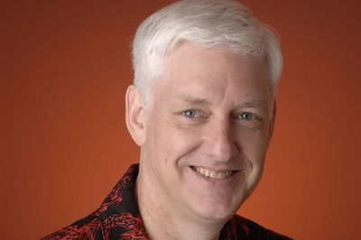
Teach Yourself Programming in Ten Years: http://norvig.com/21-days.html
Peter Norvig – Director of Research at Google
Notes:
This is peter norvig the director of research at google. He wrote an excellent article on this topic. I’m going to paraphrase but it’s well worth reading in whole.

Slide 4
The key is deliberative practice: not just doing it again and again, but challenging yourself with a task that is just beyond your current ability, trying it, analyzing your performance while and after doing it, and correcting any mistakes….
Notes:
In the essay Peter addresses the rise of books that claim to “Teach you programing in 7 days or 48 hours”. He explains that software development, like any other skill takes years of contentious practice. He goes further to state that simply practices isn’t enough…you have to do it properly. So what does he suggest?

Slide 5
Peter’s Suggestions:
Work on projects with other programmers.
Work on legacy code.
Work on your own code a year after you wrote it.
Learn at least 6 programming languages.
Learn more about computers, not just programming.
Get involved in the standards body.
Be passionate and program often.
Notes:
The first three touch on something we don’t see often in school but will in the real world. The next two are about diversity knowing several languages will help you appreciate the differences between them and give you a wider array of tools with which to solve problems. Understanding more about not just programming but the physical architecture of computers, the protocols they use to communicate, and the theory on top of which they are built will help you solve you challenges in a more holistic way and avoid problems you may have otherwise been blind to. We’ll talk about the final two points in succession. Let’s start with being involved in the standards bodies and why it’s a good idea.

Slide 6
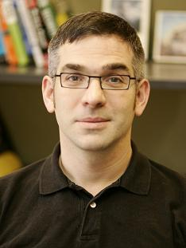
What We Actually Know About Software Development, and Why We Believe It's True: http://vimeo.com/9270320
Dr. Gregory V. Wilson
Department on computer science university of Toronto
Notes:
This is Greg Wilson, a professor at the University of Toronto. He gave an amazing talk last year called, “What we actually know about software development, and why we believe it’s true.” If there’s one thing you take away from our talk today it’s that you should go watch this talk. He espouses a view of computer science that I promise will make you a better software developer. I want to play just a small portion of the Q&A that took place after the talk.

Slide 7
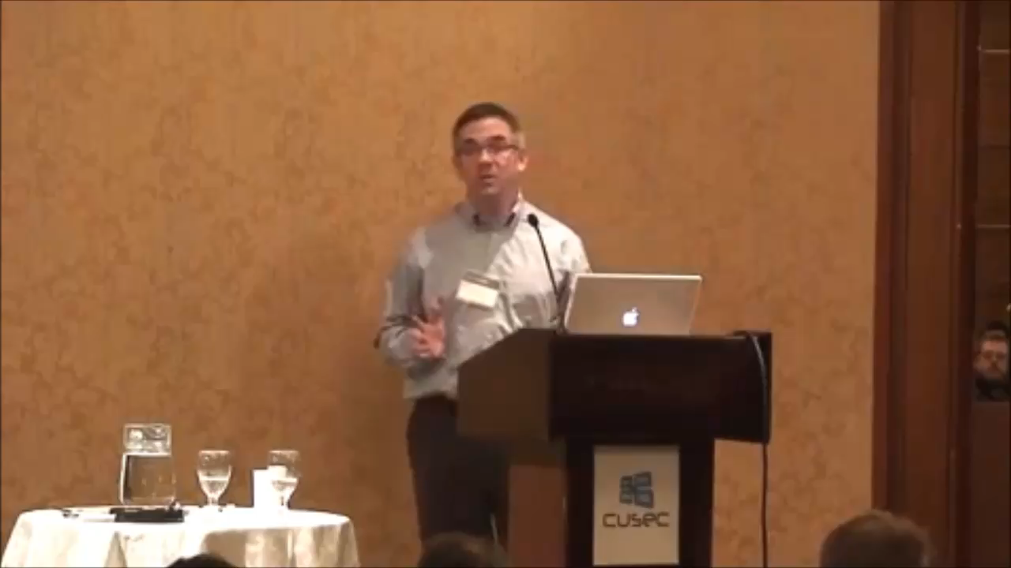
“How many of you are student members of the ACM or IEEE?”
Notes:
Awesome. I’m not sure I have much to add to what he said, though I am preaching to the choir a little bit because you’re all here and thus ahead of many of your peers. Let’s talk a little bit about getting excited about programming and how you can become more involved.

Slide 8
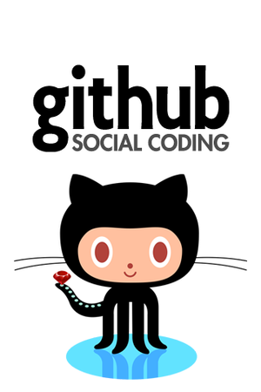
Make a github profile tonight.
https://github.com/
Notes:
Specifically let’s talk about Github. Git for those who don’t know is a version control system. It’s a way to keep track of all the changes that happen to the files in a project over time. There’s many benefits to doing this and I encourage all of you to start using version control with your personal projects. Github is an online hosting site for your git repositories. It allows you to store your code privately “in the could” or to make it open and accessible to anyone. Everyone should go home tonight and set up a github profile. The most common thing I hear when I say this is, “I don’t have anything to put on there”. Well maybe, maybe not. I’d say put the programs you’ve written for classes up. At the very least you’ve shown that you’re capable of using version control and that you’re making an attempt to be part of the community at large. There’s another important aspect of github however.

Slide 9
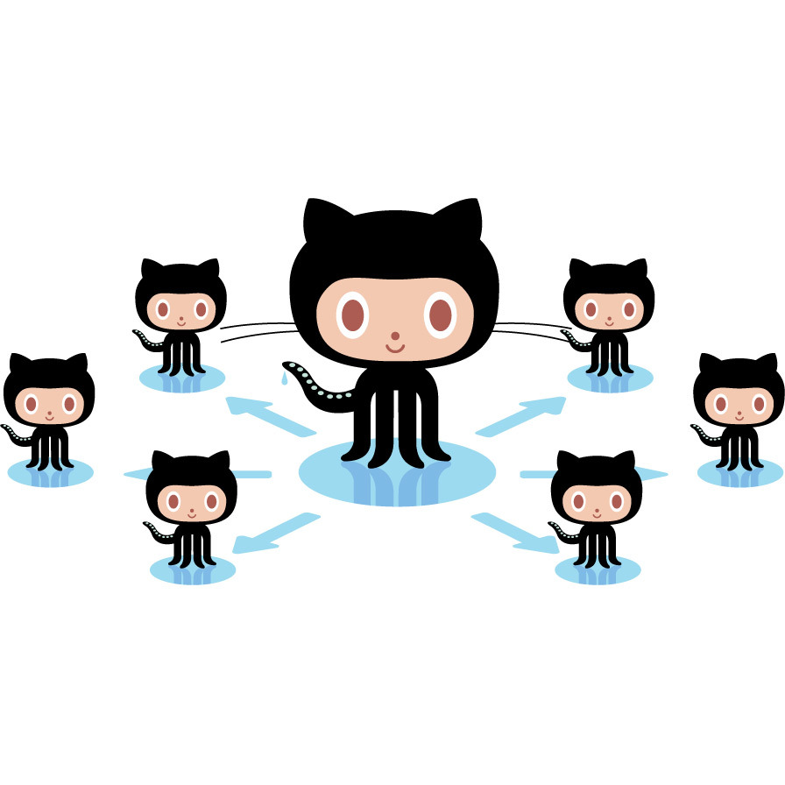
Notes:
Github let’s you see other people code. Find a project that seems interesting and try contributing to it. Seeing how other people go about writing software will make you a better developer. It will also teach you to read code, which is a huge part of a software developer’s daily job. What if you encounter something you don’t understand or can’t find on Google?

Slide 10

Create a Stack Overflow account
http://stackoverflow.com/
Notes:
Stack overflow is a social question and answer site focused on computer science. As you ask good questions or provide good answers you gain badges and reputation, which have become a measure of respect within certain computer science communities. With github and stackoverflow profiles you’ll be off to a good start building an online presence. The next step and to enter community events relevant to your interests.

Slide 11


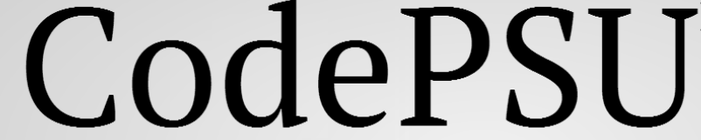
Local Penn State Events
CodePSU
Hack PSU
PSU Game Jam
http://acm.psu.edu/codepsu
https://www.hackerleague.org/hackathons/hackpsu
http://acm.psu.edu/gamejam
Notes:
Here’s a selection of events you can attend right here on campus. Each will take only a day of your time and you’ll have something great to add to your resume for it. Of course these events aren’t exclusive to penn state.

Slide 12

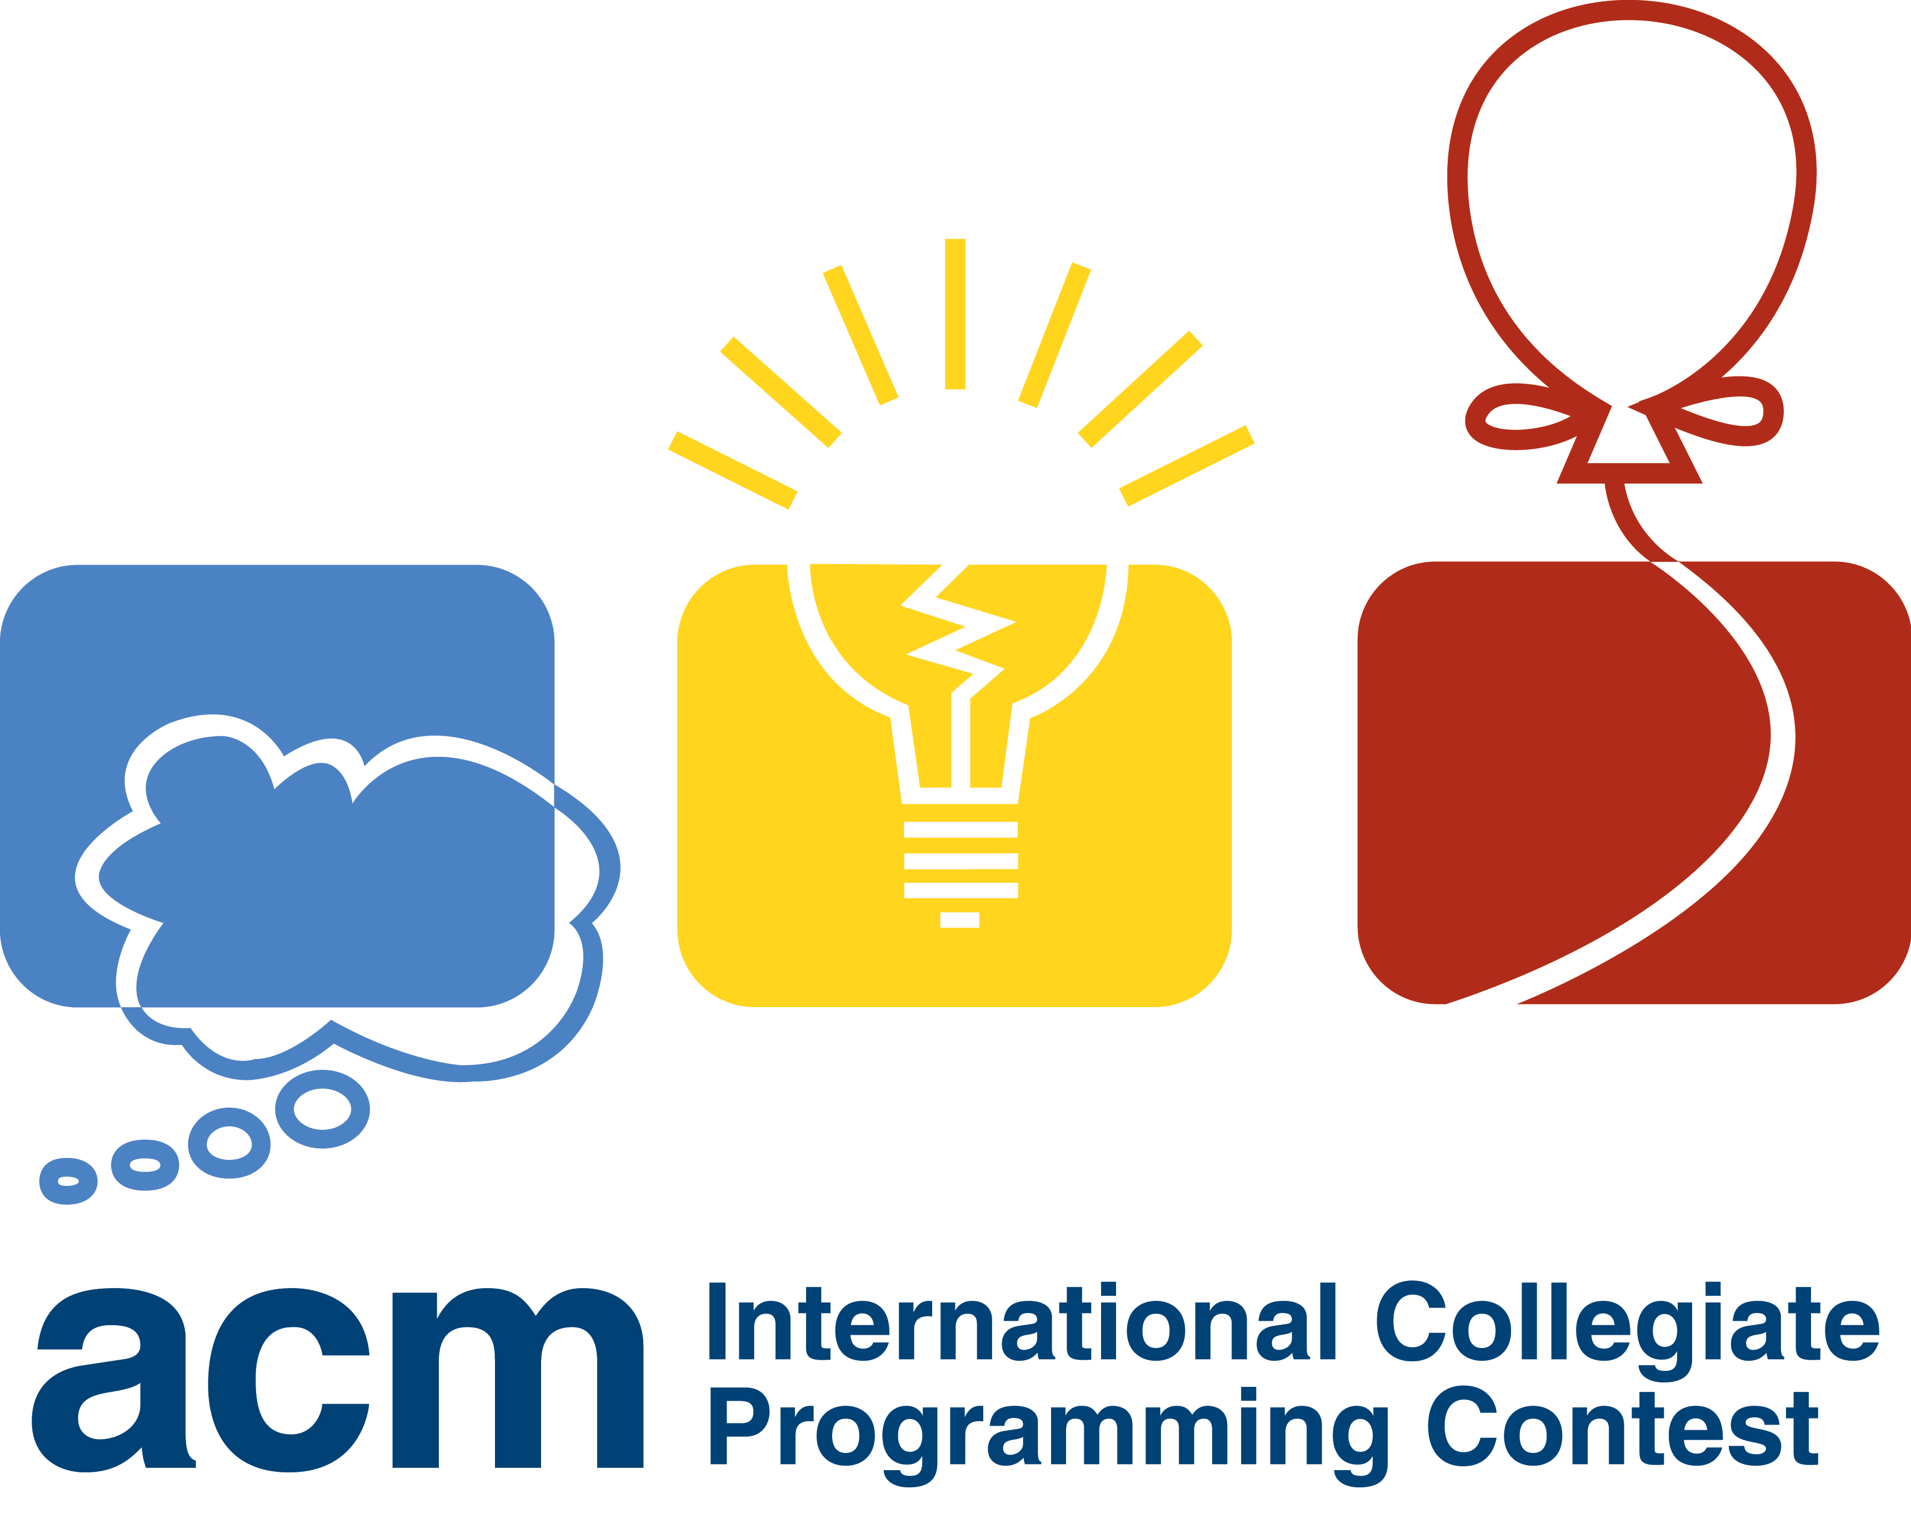
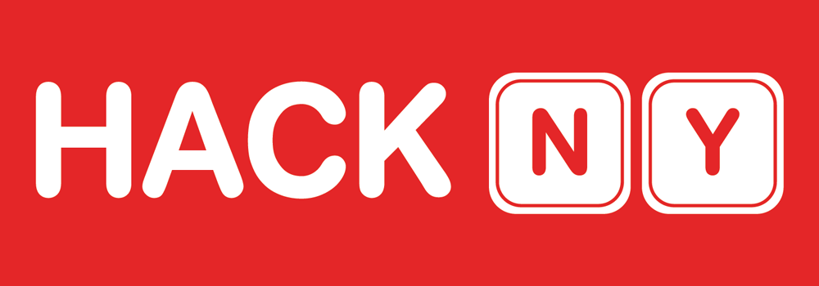
Regional Events
Pennapps
ICPC
Hack NY
http://pennapps.com
http://icpc.baylor.edu/
http://hackny.org
Notes:
Events like this are not only good experiences, they’re great for your resume, great for networking, and expose you to the culture of the computer science community outside of penn state.

Slide 13
Learning Outside the Classroom
How to master your craft
Notes:
So far we’ve talked about things you can do to become part of the larger computer science community, and these will make you a better program by getting you engaged and excited. You’ll learn a lot via osmosis alone but you may want more. Almost all of you will work as a software engineer of some form. However, you’re studying computer science and there is a gap between understanding the theory of computation and being able to implement systems in the real world. Professors here are ill equipped to help you even if they wanted to, our staff is comprised almost entirely of academics, you can count on one hand the number who have worked in industry. This leaves you to fill in many gaps on your own. Thankfully in the information age there are great resources for doing so.

Slide 14









(Udacity)
Software Debugging (CS259)
Interactive Rendering (CS291)
Automating Boring Tasks
Introduction to 3D Computer Graphics
Software Testing (CS258)
Hardware Verification (CS258)
How to make software fail
How to verify chips and eliminate bugs
Algorithms (CS215)
Artificial Intelligence for Robotics (CS373)
Crunching Social Networks
Programming a Self Driving Car
Introduction to
Parallel Programming (CS344)
Applied Cryptography(CS387)
The Science of Secrets
Using CUDA to Harness the Power of GPUs
http://www.udacity.com
Notes:
Udactiy contains college style classes taught by world class professors and instructors. It was founded by Sebastian Thurn of Standford and Dave Evans of the University of Virgina. Above are eight courses either missing from or vastly improving upon the Penn State curriculum that I would recommend to all of you but their selection is much larger. They just added the ability to receive certificates for the courses you complete and their ultimate goal is accreditation.

Slide 15
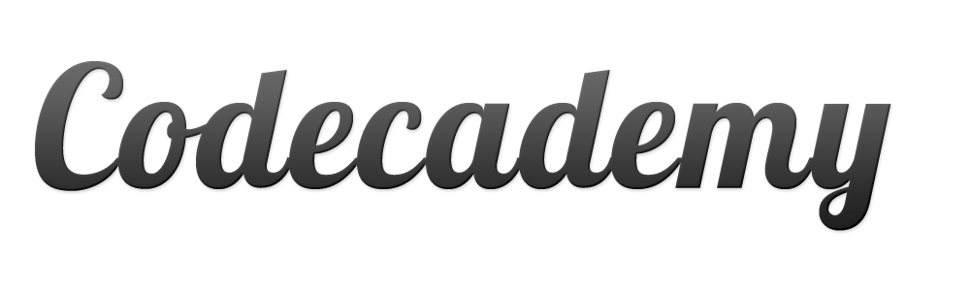
Code Academy A great way to learn a new language
http://www.codeacademy.com
Notes:
Code academy is a great site to check out if you want to pick up a new language. They have tutorials and learned exercises for most major programming languages.

Slide 16
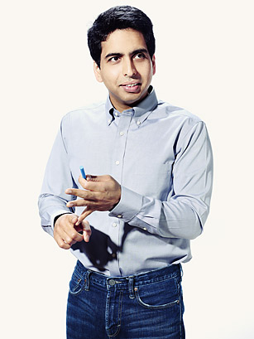

Khan Academy Video tutorials with a new computer science platform
Sal Khan – Former Hedge Fund Manager and founder of the Khan Academy
https://www.khanacademy.org/cs
TED Talk: http://on.ted.com/SalKhan
Notes:
Khan Academy, a site I’d recommend to even non computer scientists just launch a pretty cool computer science section that’s well worth checking out. I linked the founder Salman Khan’s TED talk at the bottom of the slide. It’s about the backstory of how the website came to be and is an excellent talk.

Slide 17
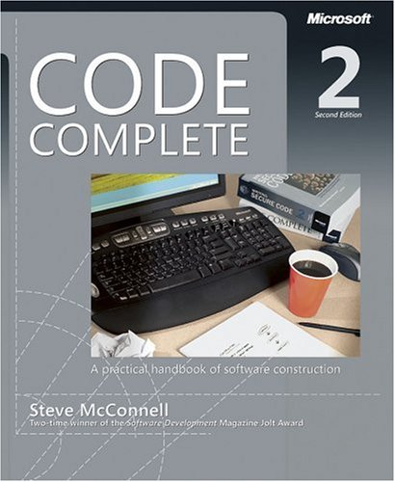
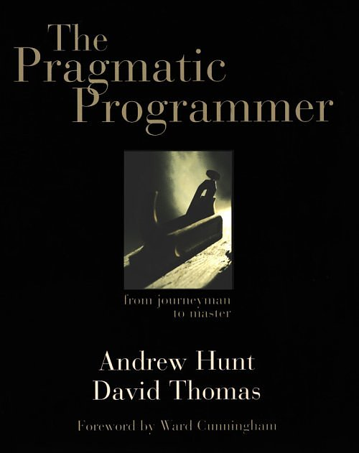
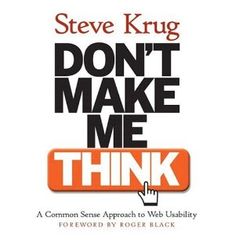
Books to Read
Code Complete
The Pragmatic Programmer
Don’t Make Me Think
Notes:
Obviously there are many books people will tell say you “need to read”. I’ve included three here that are both very well respected and very accessible to college students. The first Code Complete focuses on the mechanics of being a software developer, the second “Pragmatic Programmer” talks about the mentality a software developer needs to be successful, almost in a zen manner. The final book Don’t Make Me Think talks about user interface design, an often overlooked topic but a very important one.

Slide 18
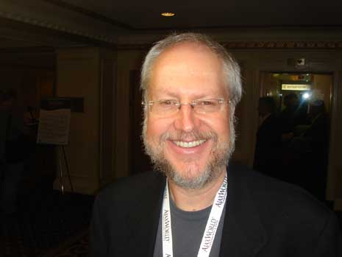
JavaScript Tutorial – Watch the first one (the history of programming): http://yuiblog.com/crockford/
Douglas Crockford – Senior Architect at Paypal
Notes:
Douglas Crockford is considered the father of modern javascript, he’s somewhat of a programming legend and his talks on Javascript have become canonical. You can watch them all if you want to become a javascript master but everyone should watch the first episode where he covers a concise history of computer programming better than most people I’ve seen.

Slide 19
Staying Connected
Notes:
If you’ve followed the advice in the preceding slides, you’re far ahead of most college students. To wrap things up I want to talk about two good resources for keeping your skills sharp.

Slide 20

Joel on Software: http://www.joelonsoftware.com/
Joel Spolsky
Founder of fog creek software and Stack Overflow
Notes:
Joel is a former program manager from Microsoft and writes an excellent blog about software development. He’s also written several books about how to recruit and interview programmers so there’s a good chance at least one of the people you talk to during your interview procress will have read his books.

Slide 21

Coder Weekly: http://coderweekly.com/
Notes:
Finally I subscribe to a newsletter called Coder Weekly and I’ve found it very worthwhile. It’s aimed at software developers, not end users and provides a nice concise list of interesting programming articles from the week.

